Slide 1
VILLA GROVE, INC
BAY SHORE APARTMENT
MF 5.8.2011

Slide 2
BAY SHORE APARTMENT 25A
310 square meters on 25th floor
2 parking spaces (5 levels of parkings)
2 main elevators & 1 service elevator
1 large social area (sitting, dining)
1 master bedroom, bathroom walkin closet
2 bedrooms with bathrooms each
Large kitche
Service area (bedroom & laundry area)
Est market value USD 620K plus
Monthly rent income USD2,000 plus

Slide 3
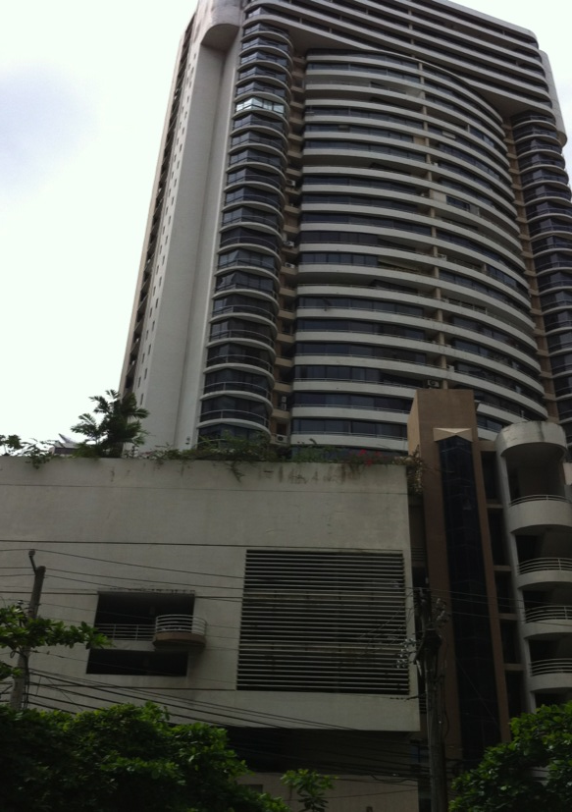
BAY SHORE APARTMENTS
APT 25A
------
------

Slide 4
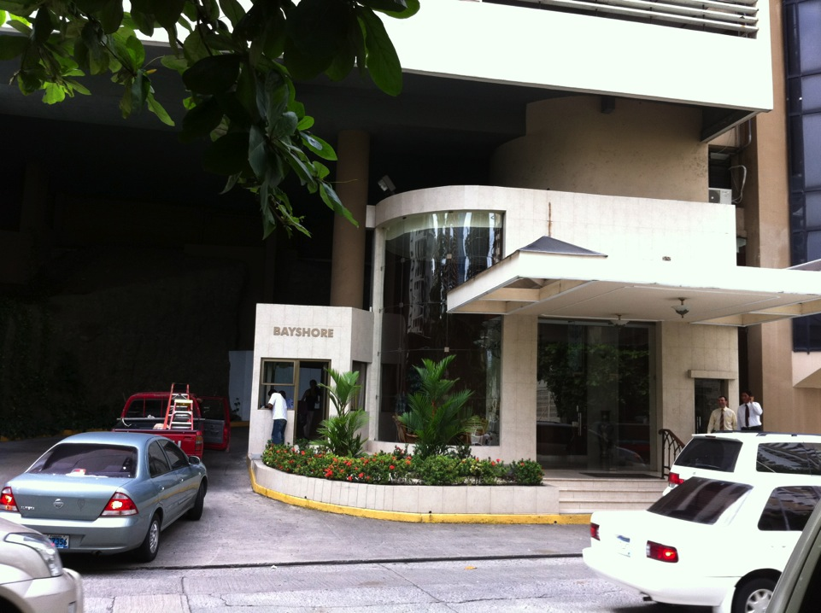
VILLA GROVE, INC
BAY SHORTE PARTMENT
AUMOIR CASE PANAMA

Slide 5
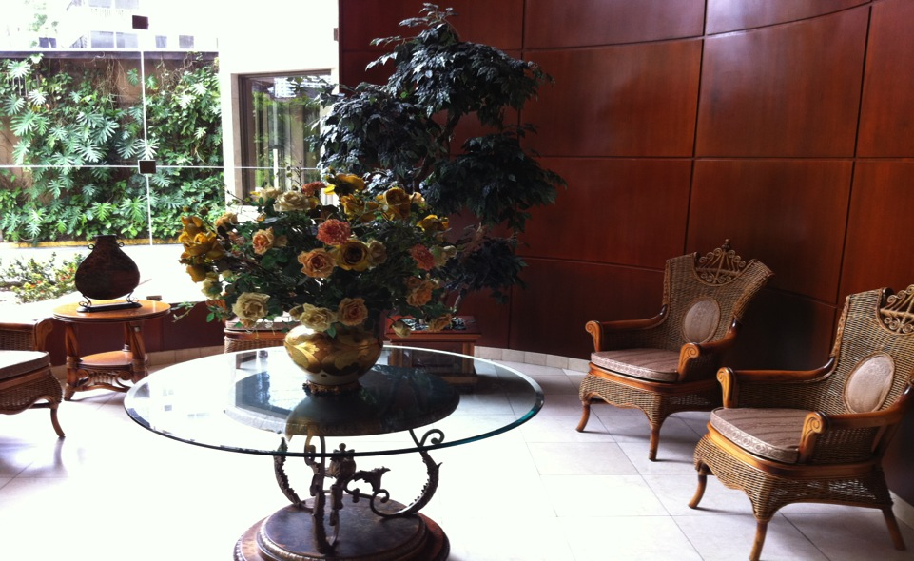
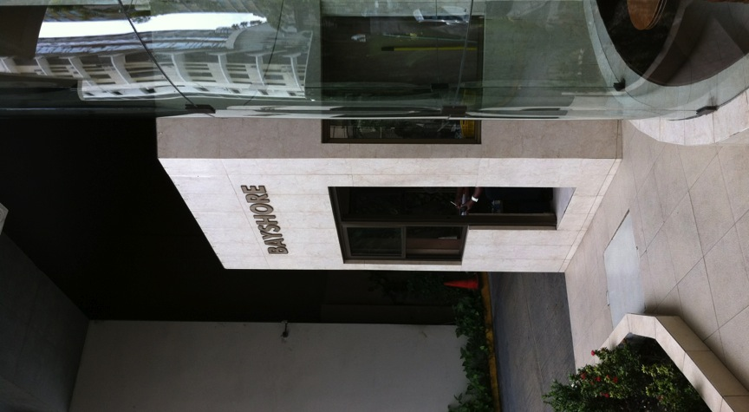
Lobby area

Slide 6
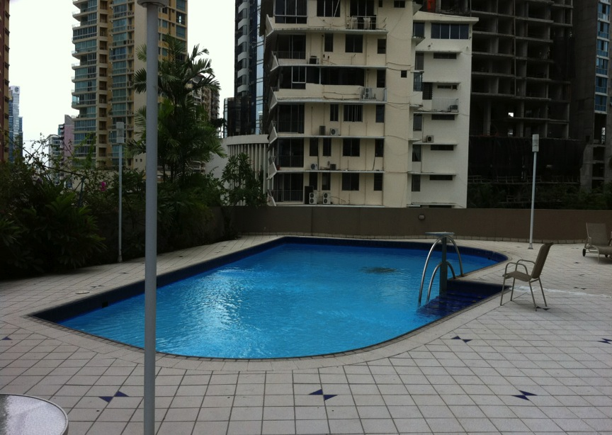

Slide 7
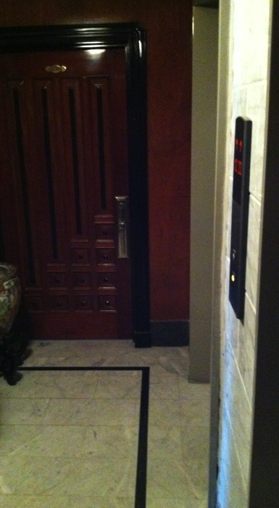

Slide 8
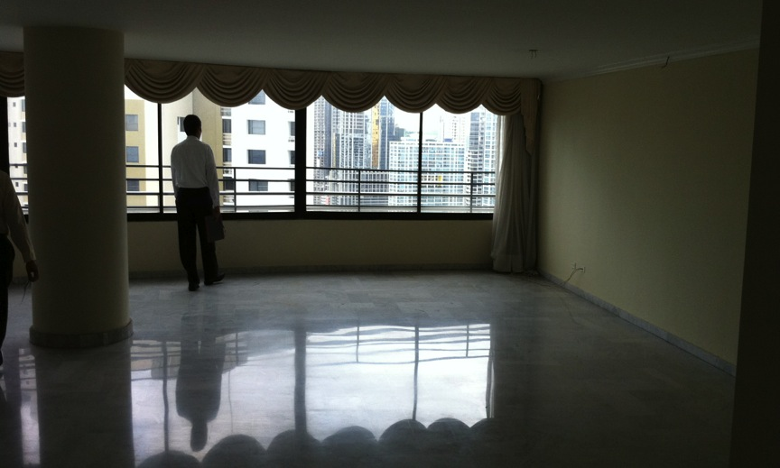
Social area

Slide 9
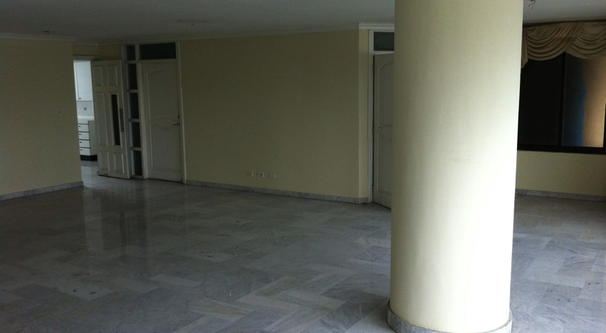
Dining area

Slide 10
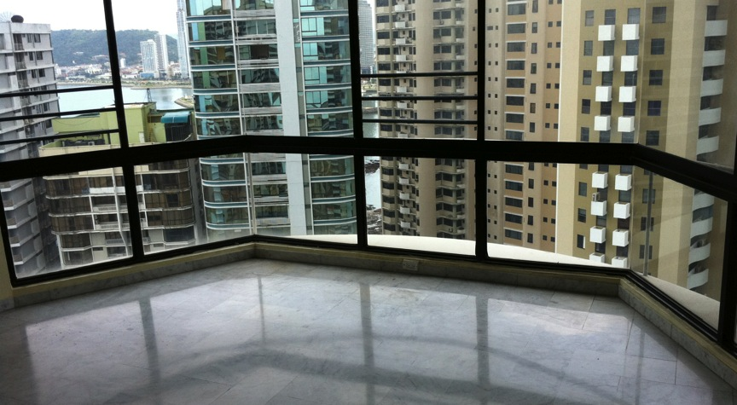
Master bedroom window

Slide 11
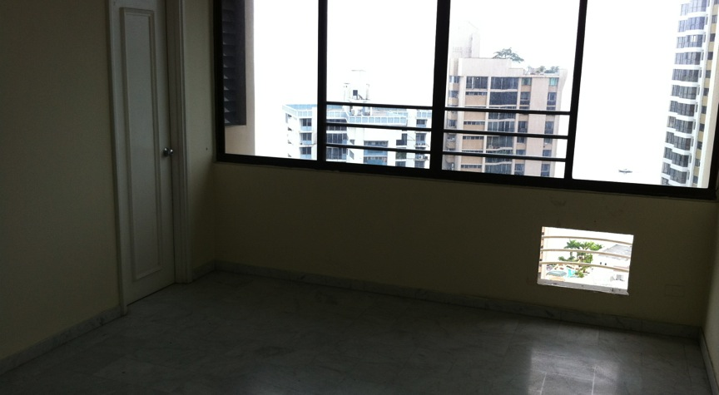
bedroom

Slide 12
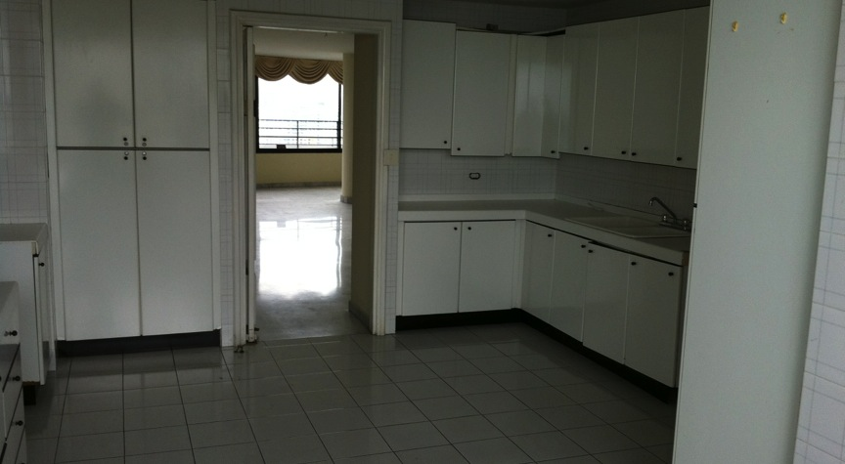
kitchen

Slide 13
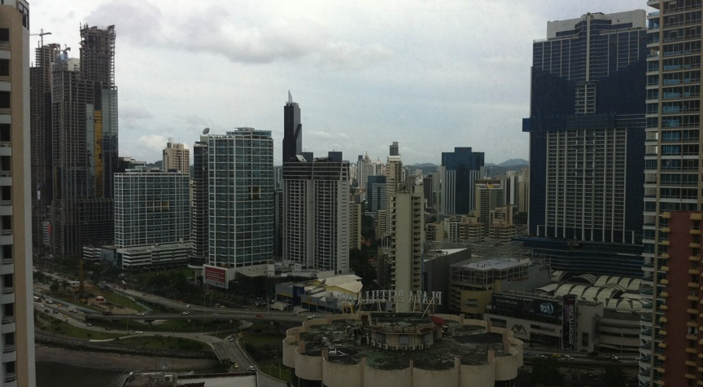
View from living room

Slide 14
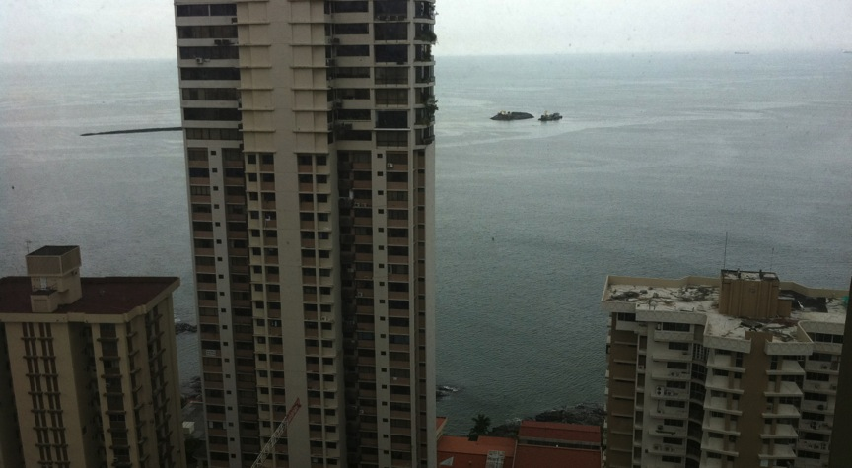
View from bedrooms/service area

